Slide 1
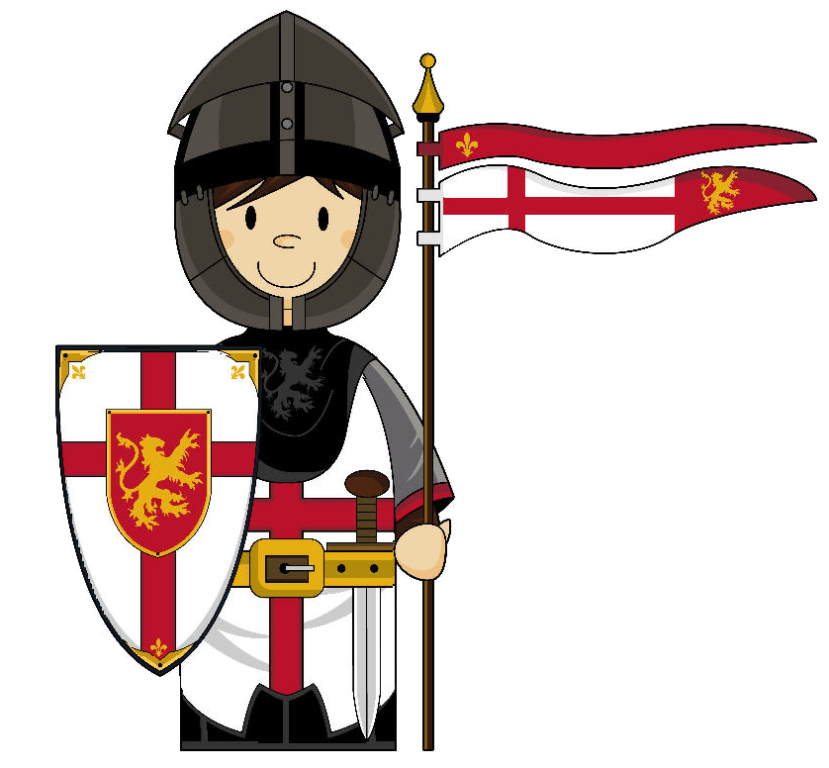
All about Saint George.

Slide 2
Who was George?
The true story of Saint George has become lost among the many legends that have been told about him.
It is most likely that he lived and died before 312 A.D., which was when emperor Constantine claimed to have seen a vision in the sky that led him to make Christianity the official religion of the Roman Empire.
George was born in the Roman Empire and became known for his love of the Christian faith which, at that time, was against the law.
He was martyred for his faith at Lydda in Roman Palestine and was buried there.

Slide 3
Stories about George.
One of the stories about George is that, while he was in Lydda, he would give his money to the poor and tell the people about Jesus.
The Roman ruler of the town had George put to death. Soon, amazing stories about him began to be told throughout Lydda. Some said that George had been chopped into pieces but God brought him back to life. Another said he had been thrown into a raging fire and God had kept him safe.

Slide 4
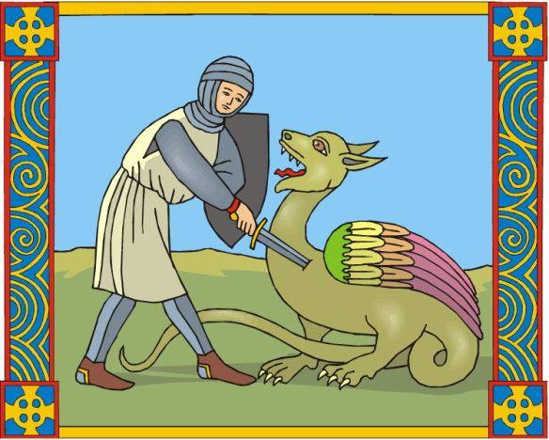
Dragon Slayer!
The most famous story about Saint George tells of him slaying a dragon. There is no proof that this actually happened but it is a very famous legend!
In olden times, people often told stories of heroic deeds. In this case it explained that George was not afraid of standing up for what he thought was right. The stories of his bravery also encouraged other people to believe in Jesus.

Slide 5
The Legend of
Saint George
Long ago, in the city of Selena, Libya, the people lived in fear. A dragon was living in the area, carrying disease and eating the sheep. The people had plenty of sheep, so they made sure there were two sheep left out for the dragon to eat every day. This satisfied the dragon's hunger and kept him away from the people.

Slide 6
For a long time this plan worked. The dragon ate the sheep and did not bother the people in the city. But, eventually, there were no sheep left.
The king decided that people would have to be sacrificed every day to satisfy the dragon. The people would draw lots to see who would be sacrificed. This upset the people but it was the law and had to be obeyed.

Slide 7
Then, one day, the king’s daughter, Princess Cleolinda, was drawn to be sacrificed. The king wanted to give all his riches to stop it happening but the people had no sympathy to offer him. They had watched their loved ones be sacrificed and wanted the king to realise how upsetting it was.
The king pleaded with the people for more time with his daughter and eventually she stayed alive for another eight days. The king spent all his time with her. On the day she was to be sacrificed, the king gave her a bridal gown to wear as she was lead to the dragon’s lair.

Slide 8
Princess Cleolinda was hiding in some long grass. George was riding along on his horse and asked what was wrong. The princess explained what had been happening.
George was dismayed. He said he would help the princess and her people. He knew God would help him.

Slide 9
As they were talking the dragon approached. George drew his sword and made the sign of the cross of Jesus. Then he fought the dragon, injuring him but not killing him.
At once, the dragon became as meek as a lamb. George and Princess Cleolinda led the dragon into the city. The people were afraid but George told them not to be.

Slide 10
George told the people that his belief in God and Jesus Christ had saved the day. He told them he would slay the dragon if they asked to be baptised.
The king was overjoyed to see his daughter returned safely. He was the first to be baptised and the people all followed his example. George then killed the dragon.
The king built a church in George’s honour. He offered George great wealth but George told him to use it to look after the church and priests.

Slide 11
Saint George’s Day
Saint George’s Day has been celebrated in England since 1222. It was decided that April 23rd should be a holy day.
Today, Saint George is most vividly remembered in England for the cross that he is said to have worn on his armour – red on a white background. The cross has become a sign of national pride and is seen on the English and British flag.

Slide 12
Presentation ©Bev Evans, 2009
www.communication4all.co.uk
Animations available from
www.animationfactory.com

